Slide 1



G2-5 Project
Library Management software
Deniz Işık
Mahammad Azizov
Emirhan Tepebaşı
Zahari Nedev
Wassim Mezghani

Slide 2

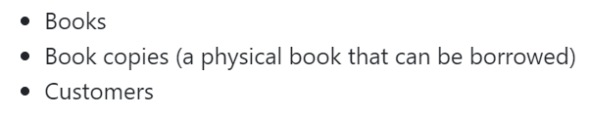
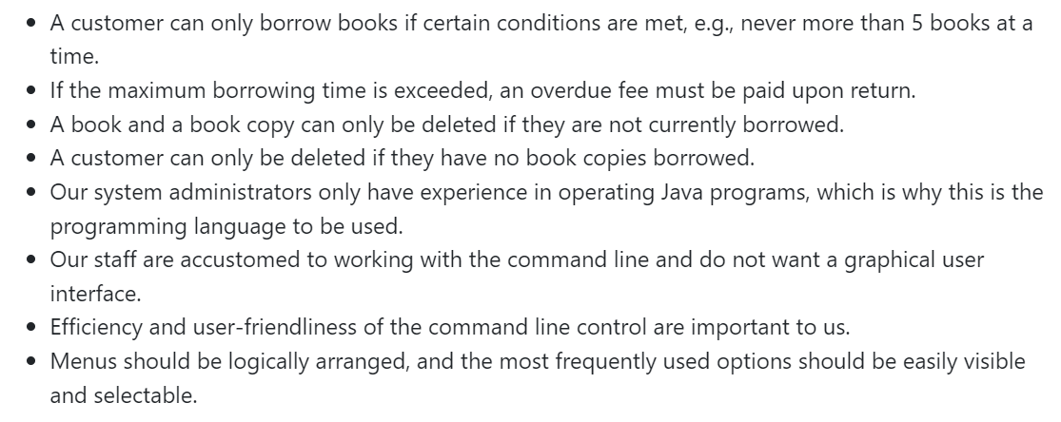
Task 1: Specification
In this assignment, we have created a pdf file which includes 15 questions (3 per person) about the given types of data:
About the given methods and requirements:

Slide 3
1.Do you want the users to be able to see a short description about the book after finding one?
2.Should the users be able to reserve the books, and if so can you clarify the reservation process?
3.Would you like the virtual books to be encrypted and their screenshots, copies, etc. to be banned with respect to copyright issues?
4.What should the users do or bring in order to borrow and return a book copy?
5.What type of regulations does the library have if the books got damaged or lost?
6.What type of file with books might be imported?
7.Is there a specific order you would like to see the books displayed in, such as alphabetical order or according to genres?
8.How should the overdue fee be calculated when a customer returns the book with a delay? Should it be based on the book's value, the time he exceeded after the deadline or something else?
9.How should returns be handled, and is there any specific process or verification required?
10.What would you like us to do if a customer does not return the book at all? Should he be sent an email and a final warning per post or something else?
11.Could you specify how would you like us to handle user support / help?
12.Which security features would you like the users' accounts to be protected with?
13.Can you specify the duration for which a book can be borrowed before it's considered overdue?
14.Additionally, do students or scholars have any specific benefits or privileges regarding borrowing books?
15.Should the system be able to handle a growing number of books, copies, and customers?
1.Do you want the users to be able to see a short description about the book after finding one?
2.Should the users be able to reserve the books, and if so can you clarify the reservation process?
3.Would you like the virtual books to be encrypted and their screenshots, copies, etc. to be banned with respect to copyright issues?
4.What should the users do or bring in order to borrow and return a book copy?
5.What type of regulations does the library have if the books got damaged or lost?
6.What type of file with books might be imported?
7.Is there a specific order you would like to see the books displayed in, such as alphabetical order or according to genres?
8.How should the overdue fee be calculated when a customer returns the book with a delay? Should it be based on the book's value, the time he exceeded after the deadline or something else?
9.How should returns be handled, and is there any specific process or verification required?
10.What would you like us to do if a customer does not return the book at all? Should he be sent an email and a final warning per post or something else?
11.Could you specify how would you like us to handle user support / help?
12.Which security features would you like the users' accounts to be protected with?
13.Can you specify the duration for which a book can be borrowed before it's considered overdue?
14.Additionally, do students or scholars have any specific benefits or privileges regarding borrowing books?
15.Should the system be able to handle a growing number of books, copies, and customers?

Slide 4
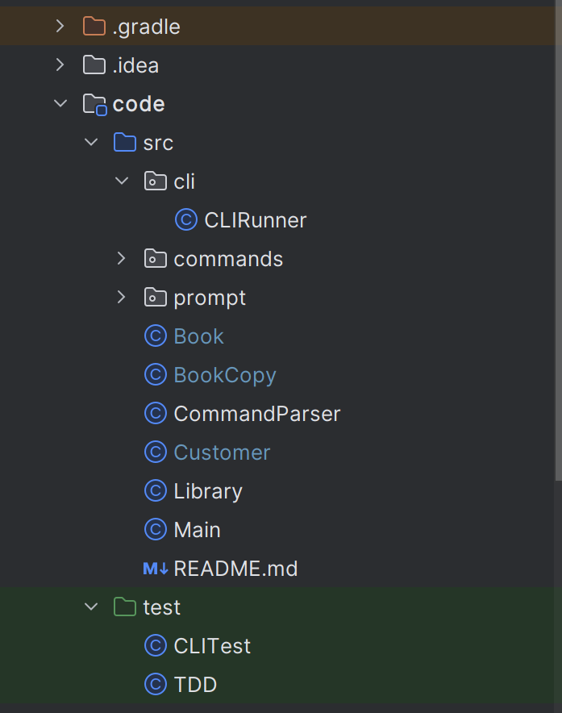
Task 2: Specification
Library: manages a collection of books, book copies, and customers, providing methods for adding, deleting, and importing these entities from CSV files, as well as functionalities for searching and managing book borrowings.
Customer: represents a library customer with attributes such as ID, name, payment status, and a list of borrowed book copies, and includes methods for borrowing and returning books.
Book : a book with attributes such as title, author, publication year, ISBN, and publisher.
BookCopy represents a copy of a book with attributes such as title, author, publication year, unique ID, borrow status, customer ID, and publisher .
CommandParser
command-line interface(CLI)

Slide 5
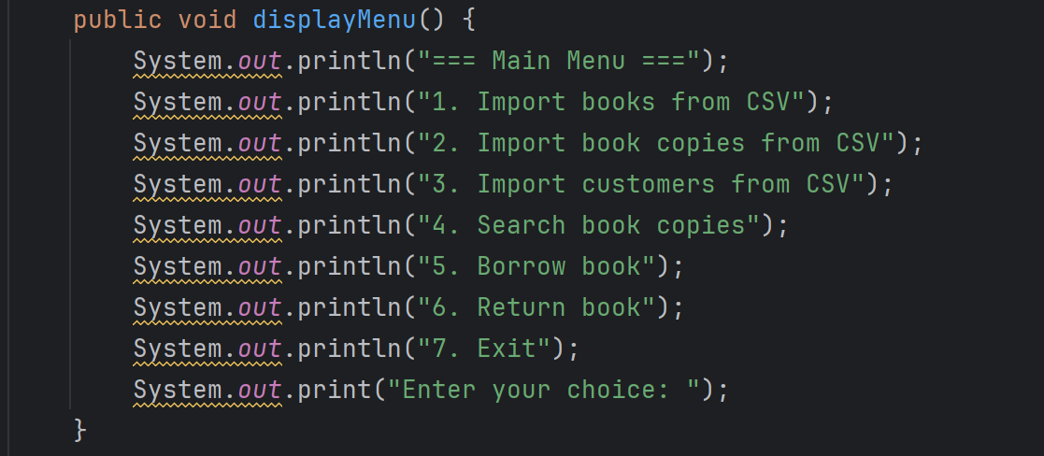
CommandParser
The CommandParser class facilitates interaction between the user and the library system by providing a command-line interface for importing books, book copies, and customers from CSV files, as well as for searching, borrowing, and returning book copies. It uses a `Scanner` to read user inputs and executes the appropriate actions based on the user's menu selections.

Slide 6
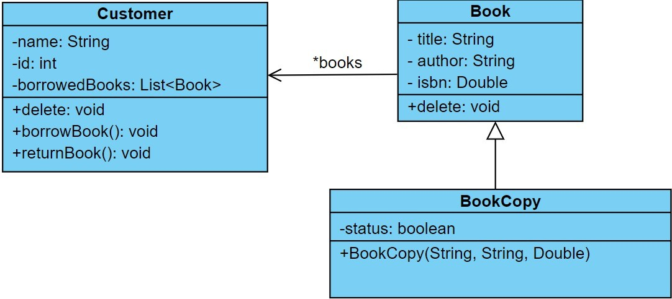
UML Diagram

Slide 7
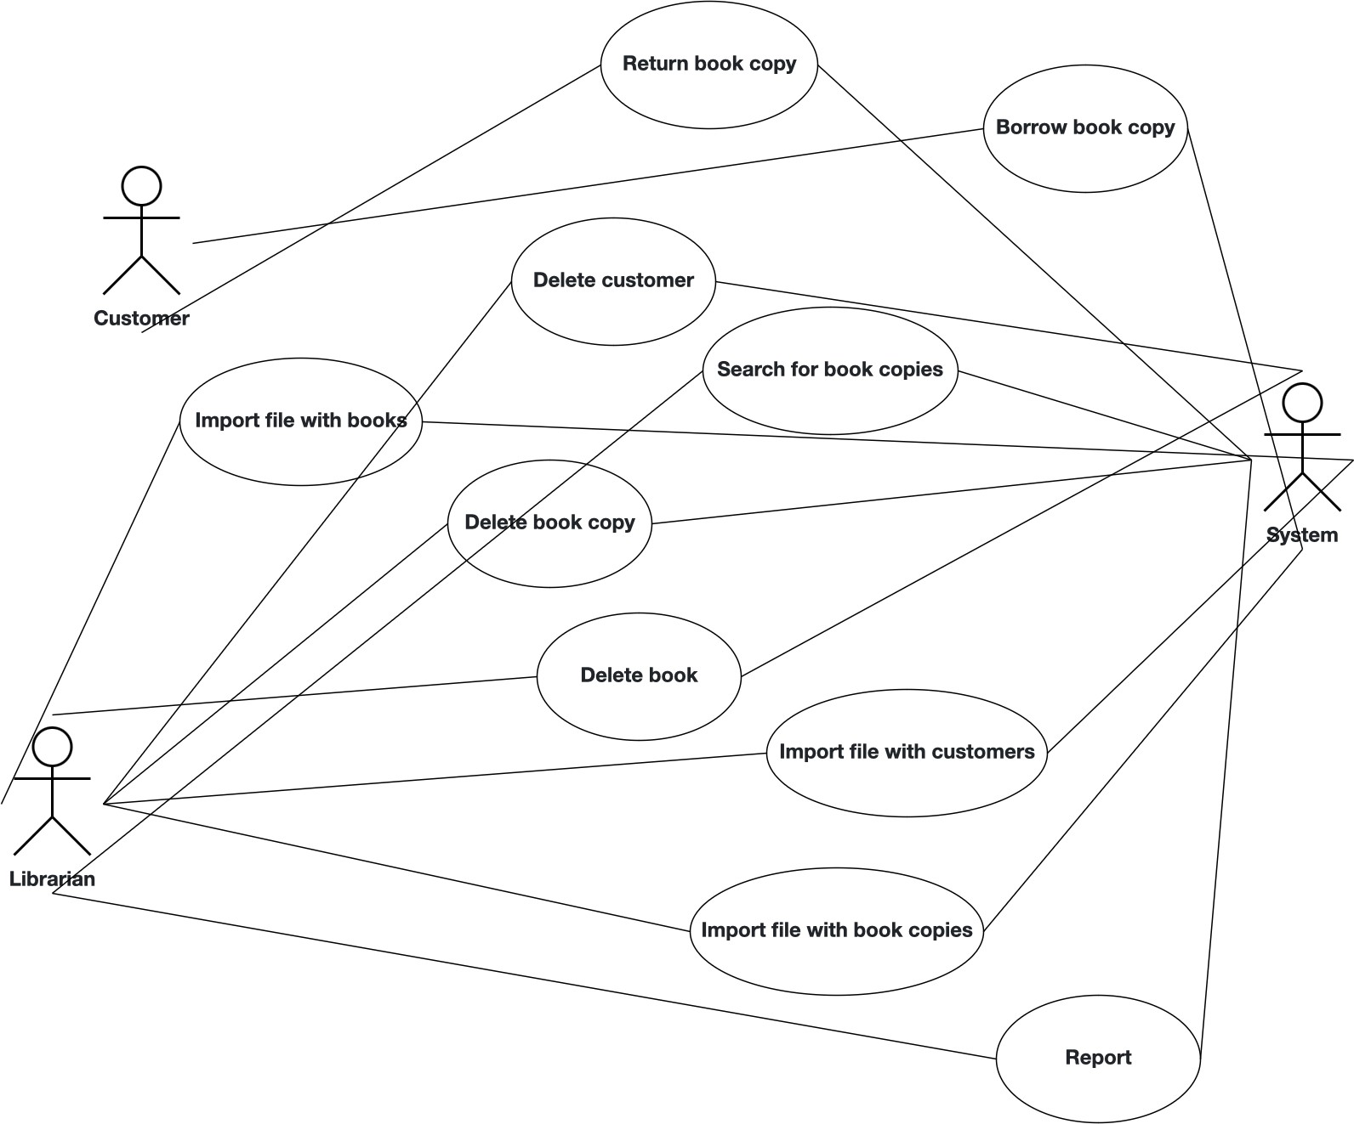
Use case Diagram

Slide 8
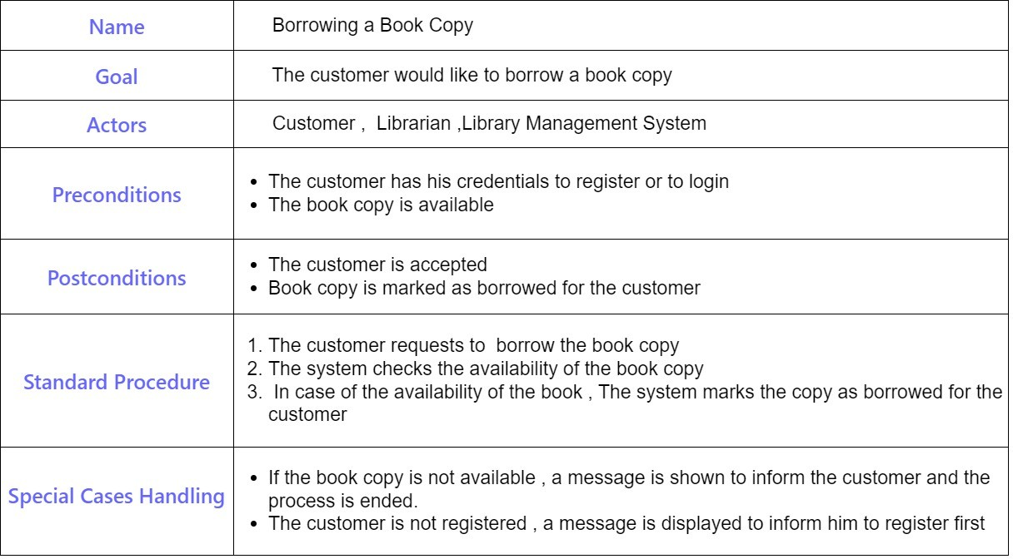
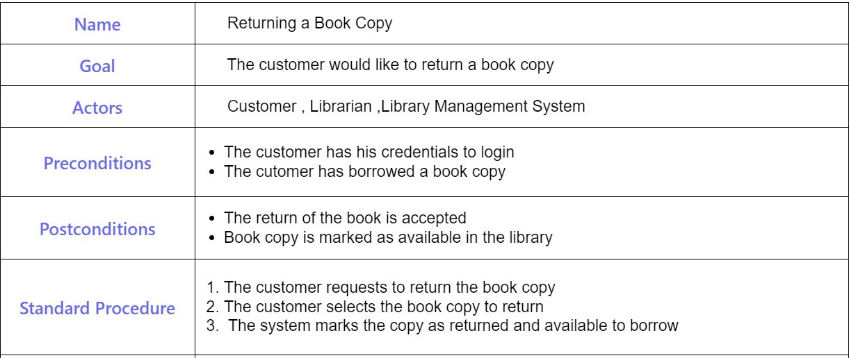
Use case tables

Slide 9

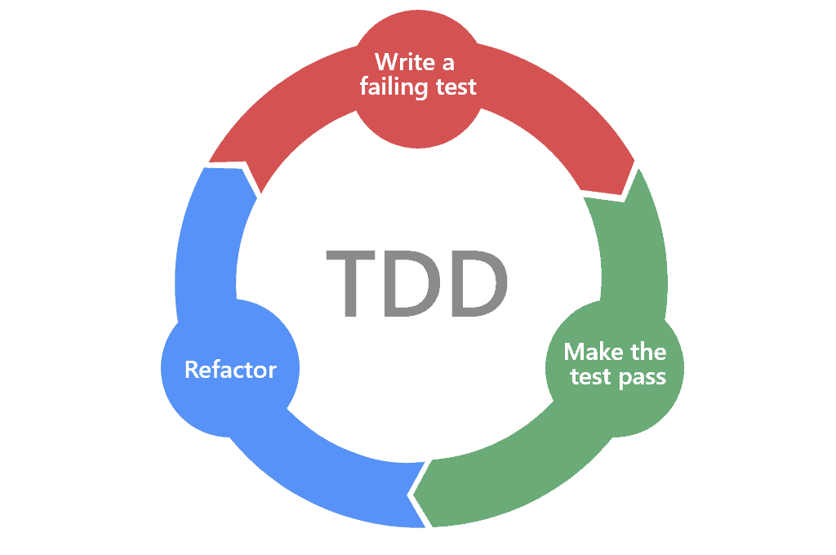

Task 3:Test Case Creation
Implementation of test classes for various methods by employing two distinct testing methodologies:
Unit tests, utilizing the JUnit 5 framework.
Test-driven development (TDD), ensuring that our tests guided the development process from the start.
Test Coverage Report :
The test coverage report provides insights into the extent of code coverage achieved by the implemented test cases. The report is generated using JaCoCo, an open-source Java code coverage library.
Readme file Test documentation:
We added the plugin used for Test coverage report generation by running the following command:

Slide 10

Task 4:Implementation
Requirements:
Using Gradle - Build Tool
Test Cases
Implementation
What we have done:
Used build tool to link project to Gradle
Created test cases for required methods
Implemented methods according to tests:
Import CSV file
Searching functionality
Reporting

Slide 11
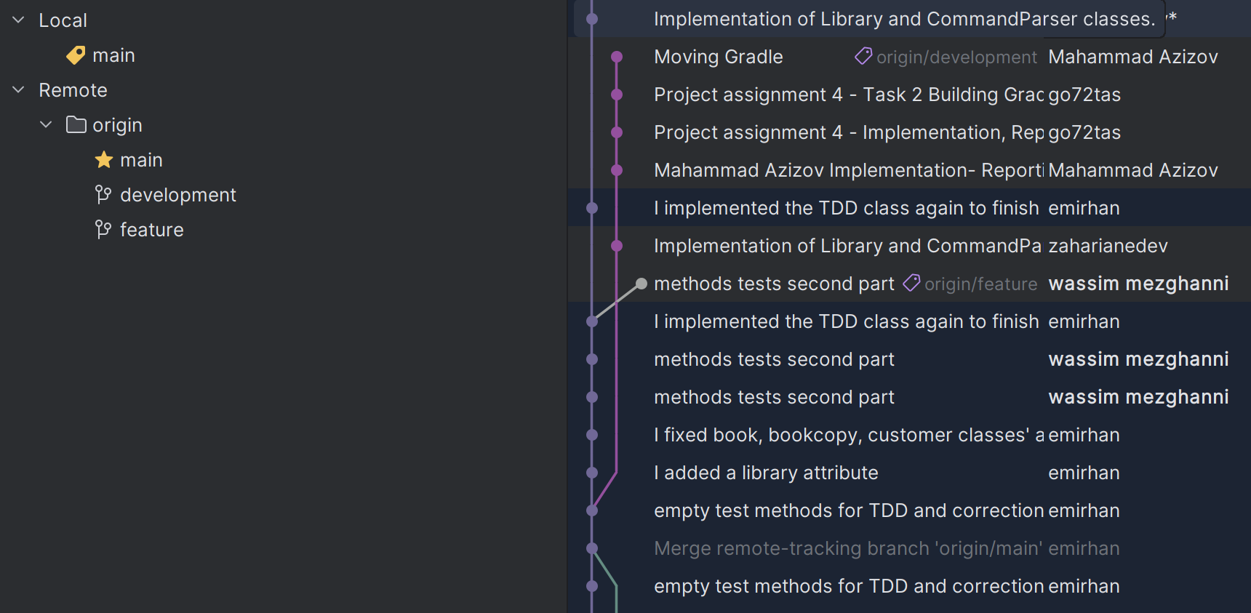
Git branches
Branching model for team development:
Development: the "Development" branches serves as the primary branch where the latest development changes are integrated and tested.
Feature: The "feature" branches are used for individual feature development, allowing team members to work on new features independently before merging them back into the "Development" branch once they are complete and tested.

Slide 12

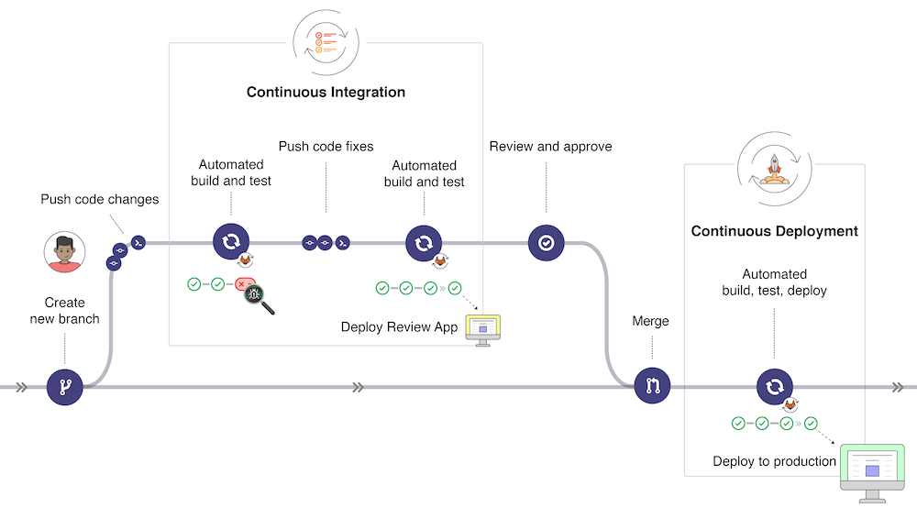
Git branches
Process after creating a new branch:
Push code changes
Build and test code
Fix code
Review and approve
Merge (conflicts requests!!)

Slide 13
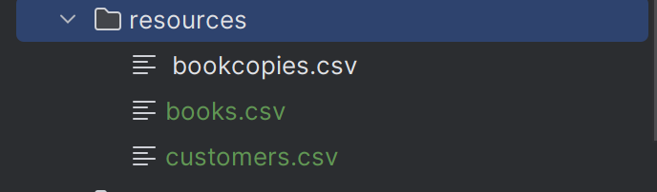

Task 5:Maintenance and Evolution
Task1 :
we used merge requests with code review to :
Implement the functionalities required in this assignement
ensure good Quality code
Task2 :
We had to create a CSV file and a method which outputs the publishers’ name and the book copies per publisher in this assignment. We created 3 csv files :

Slide 14
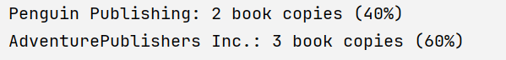
CSV file to store book copies:
CSV file to store books :
CSV file to store customers:
Task3 :
Task 3 was about to output the information with the percentage.
As we created 5 book copies the output looked like this:

Slide 15

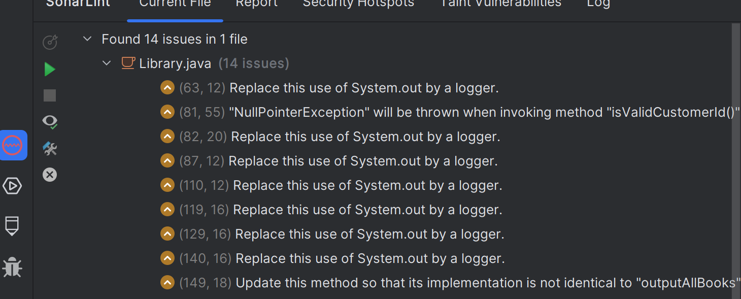
Task 6:Quality Assurance
Analysis of our developed application :
For analyzing our developed application for vulnerabilities in terms of software quality, we utilized tools such as SonarQube, SpotBugs, Checkstyle, and PMD to enhance maintainability and the capability to evolve.
We used a template:
the vulnerability location : (Code/src/Library/149,18)
Identified by tool support: Sonarlint
Brief description of the vulnerability:
Possible negative impacts if the vulnerability is not addressed:

Slide 16
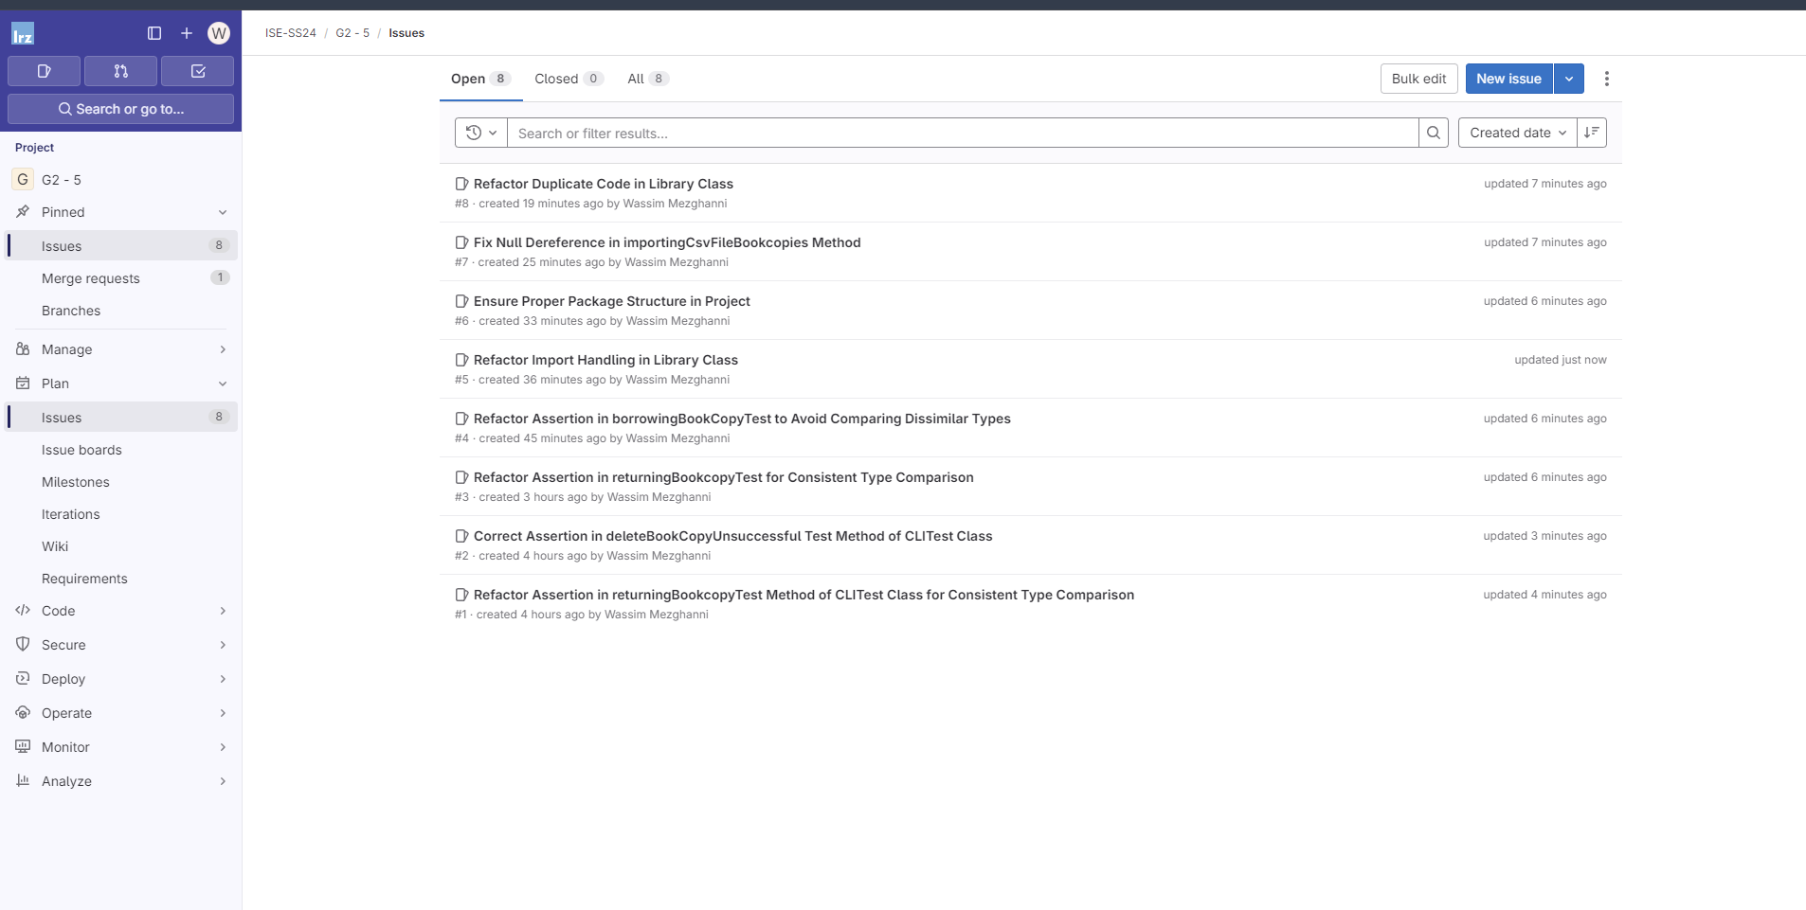

We found 16 issues to fix

Slide 17


Refactoring :
We created a separate Merge Request for each vulnerability, which was reviewed by a team member. The Merge Request was linked to the issue of the addressed vulnerability and described how the vulnerability was fixed.
We used the following template for the description of the Merge Request:
Description:
-Link to the issue describing the vulnerability
- Brief description of how the vulnerability was fixed

Slide 18

Review
Challenges:
Working with and understanding GitLab CI/CD
Implementing Gradle
From a broader perspective: time management
What we have learned:
Working together as a team
Branches, merge requests, rollback, etc.
How to structure a project
Better idea of the work environment of a software developer

Slide 19
Possible improvements
Improvements:
Setup Continuous Integration pipeline with adding gitlab-ci.yml file to ensure automated testing, building, and deployment, leading to faster development cycles and higher code quality.
Use more features provided by Gitlab CI/CD interface
Use CI/CD analytics shows the history of pipeline successes and failures, as well as how long each pipeline ran.
Fix uncovered bugs manually and with help of tools

